Slide 1
Wikipedia Category Recommender using Neural Networks
CS767 Final Project
John Liao
Fall Semester - OY1 2019
Notes:
Hello, my name is John Liao and I will be providing a brief presentation on my final project for CS 767. The project goal is to build a recommender system using neural networks using Wikipedia articles and corresponding categories.

Slide 2
Outline
Introduction/Use Case
Design/Implementation
Sample: Preprocessing Input Data
Results
Demo
Notes:
I will be discussing an introduction, design and implementation with a sample of preprocessing a sample input data, results and a brief demo.

Slide 3
Introduction/Use Case
Build neural network that provides recommended categories based on input text
Input
Output
Wang Leehom (born May 17, 1976), sometimes credited as Leehom Wang, is a Chinese-American[2] singer-songwriter, actor, producer, and film director. Formally trained at the Eastman School of Music, Williams College and Berklee College of Music, his musical style is known for fusing Chinese elements (such as Beijing opera, traditional styles of ethnic minorities, Chinese classical orchestra) with hip-hop and R&B.
1976 births, Living people, American expatriates in Taiwan, Film producers from New York (state), American male film actors... New York, 21st-century American singers, Record producers from New York (state), 21st-century violinists
Notes:
The main goal is to build the recommendation system using Wikipedia articles as input. Each Wikipedia article has a list of categories at the bottom of each page.
In this example, an input for a given living person is provided (wang Lee Hom, a famous Taiwanese singer) and the categories are provided: 1976 births, living people, American expatriates in Taiwan, etc.
The goal is to have for any given input of unstructured text, the application would be able to provide a recommended output category.

Slide 4
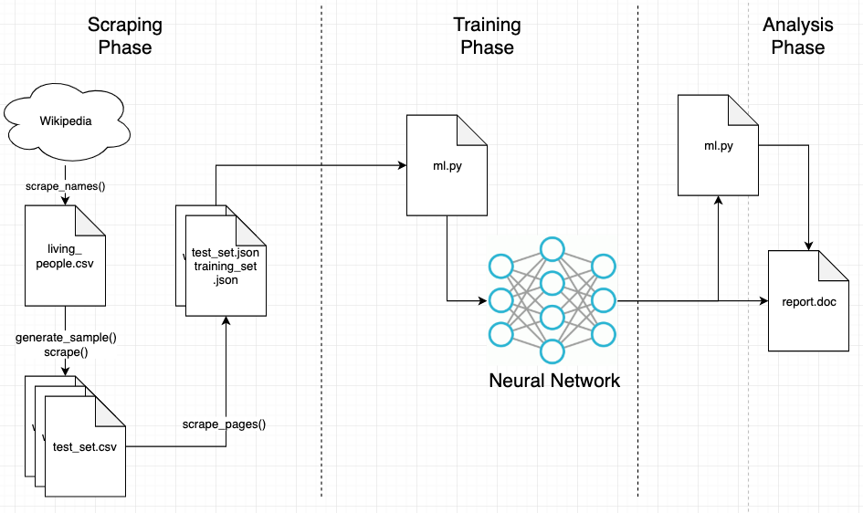
Design/Implementation
Python Tensorflow used
Preprocessed and cleaned input text data (cleaning/vectorization)
Scraped 100,000+ data points from Wikipedia
75/25% ratio for training/test data
2x layers for neural network
10 epochs and auto-selected batch size
Notes:
For the design and implementation, Python tensor flow was used.
The input text was preprocessed and cleaned so that it was able to be ingested into the neural network. I will go over an example of this process in the next slide.
Over 100,000 Wikipedia articles and categories were scraped and are available online. This process took 8-12 hours.
For a breakdown of training and test data, the ratio is 75/25 respectively
This was not a deep nural network with only a single input a layer and a single output layer.
10 epochs was the number selected for training and model fitting. The batch size was automatically selected by Keras.
The overall workflow is broken into 3 phases: scraping, training and analysis. During the scraping phase, the data is collected from Wikipedia using their API. The training phase is reading the data into the neural network model, and the analysis is generation of the final report.

Slide 5
Sample: Preprocessing Input Data
Notes:
This is an example of pre-processing and cleaning the data.
The cleaning of the input data involves:
Removes punctuation
Tokenizes the text
Removes stop words (it, is, etc)
Perform stemming – Normalizes words due to different suffixes (e.g. organizes, organizing, organization -> organiz)
Then vectorize the input data. For this project, I used the bag of words approach.

Slide 6
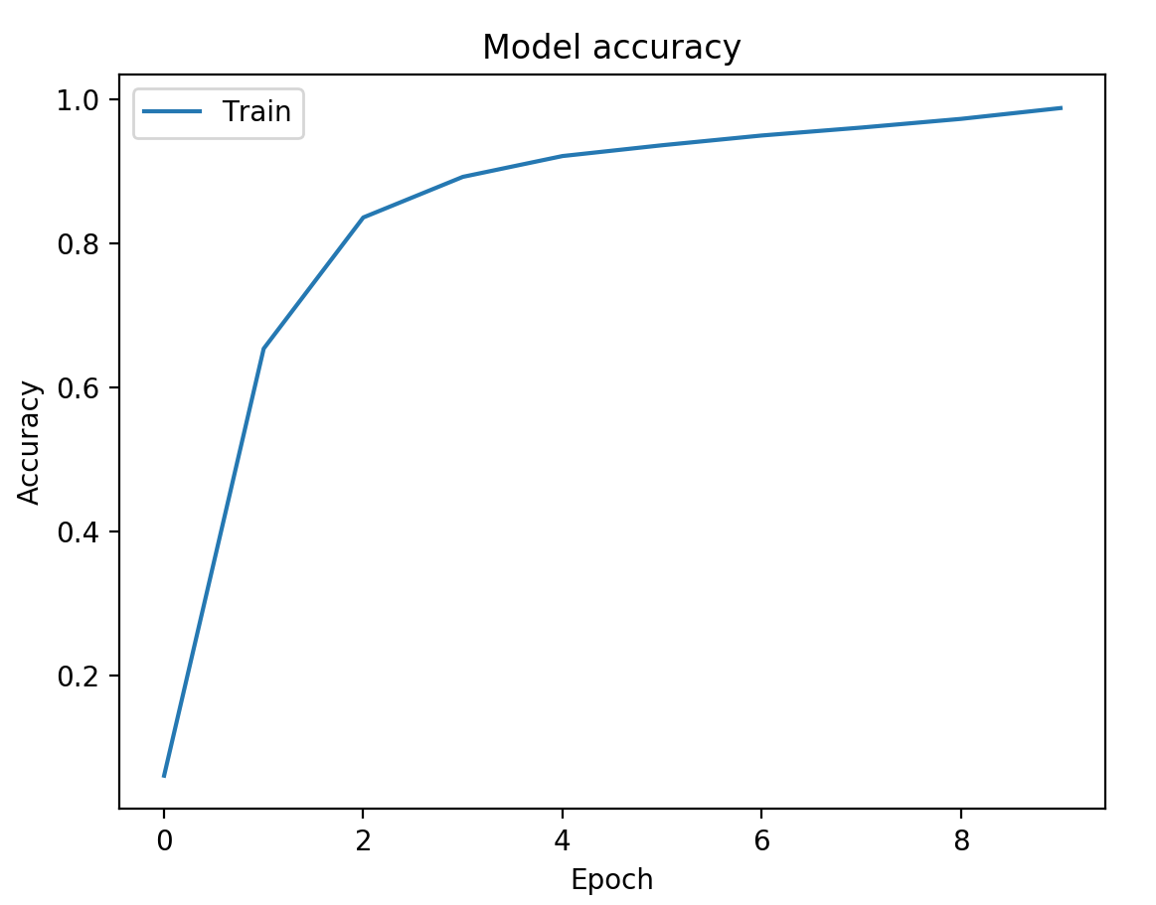
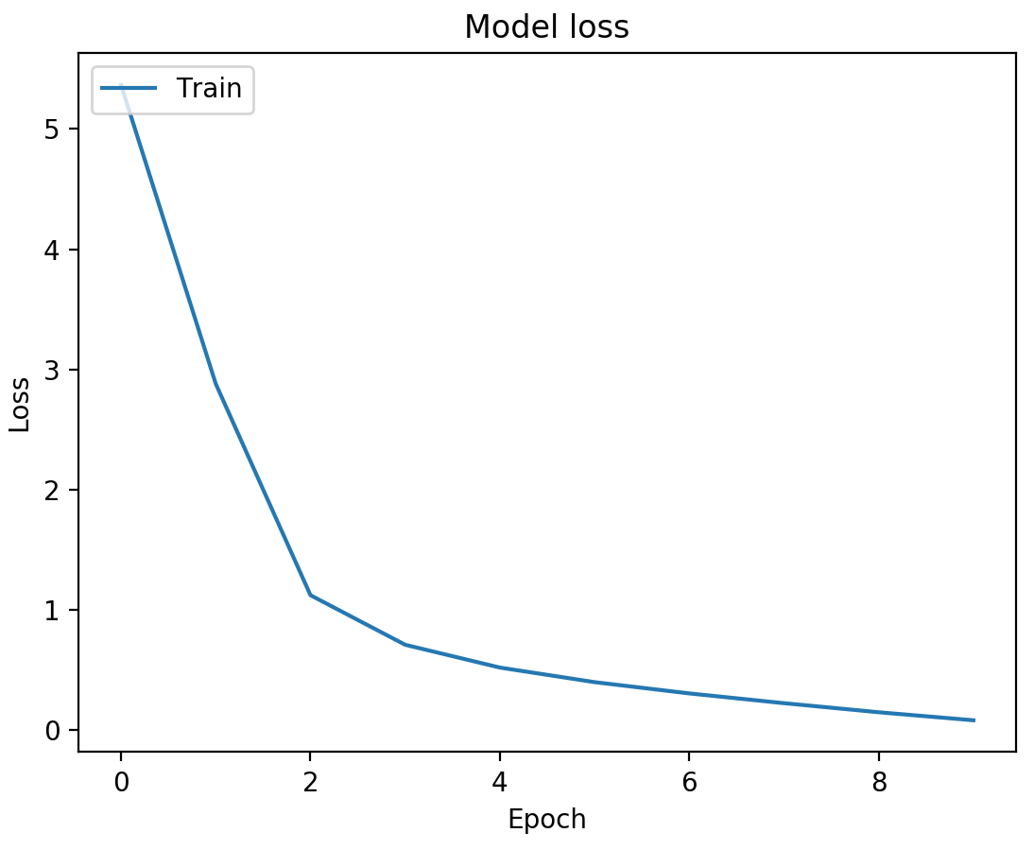
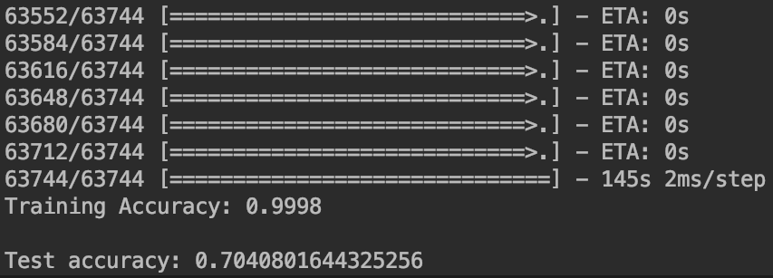
Results
99.98% training data accuracy achieved
70% test data accuracy achieved
https://github.com/johnsliao/cs767-final-project
Notes:
The result of the project was quite successful. For the given 100,000 input data set, the test set was able to achieve 70% accuracy. The epoch number was properly optimized for accuracy and model loss was minimized as well.

Slide 7
Demo
Notes:
The following demo shows a run through of building the model against a sample size of 1000 items with the same 75/25% breakdown for training and test data.
The low test accuracy is indicative of the data set being too small to properly train the model.
This source code is online in the aforementioned github repository.

